Slide 1
New Home Energy Storage Pilot (NHESP)
1
Notes:
-Ruby

Slide 2
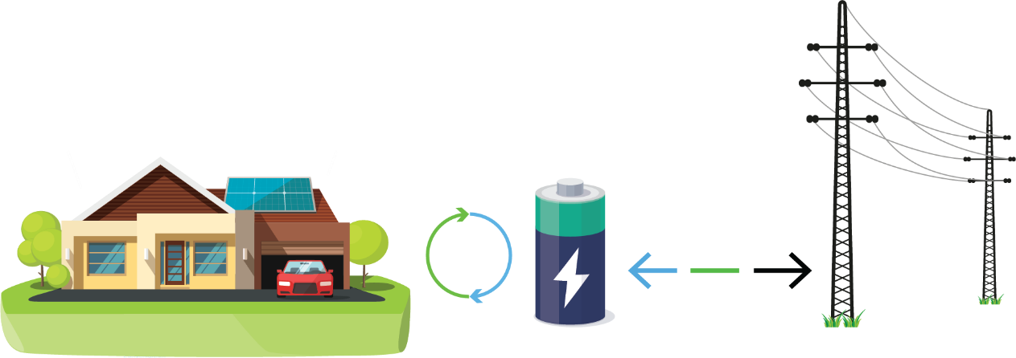
New Home Energy Storage Pilot (NHESP)
The New Home Energy Storage Pilot (NHESP) is intended to provide financial incentives for the installation of approximately 2,400 energy storage systems for qualified single-family or multi-family residential housing developments.
NHESP Incentive Levels
Incentives are paid directly to building developers who pre-install energy storage paired with solar systems
Incentive Budget $4,189,185
Pilot tentative launch date May 22, 2023
Housing Type | Incentive Rate
Affordable Housing* | $0.765/Wh
General Market or Mixed-Use | $0.135/Wh
Applications for this pilot will be accepted until November 2024.
Applications will be on a “first come, first serve” basis.
*Must meet affordable Housing Eligibility criteria requirements
SCE will maintain a waitlist of valid applications

Slide 3
New Home Energy Storage Pilot (NHESP)
Eligibility Criteria
To be eligible for the NHESP you must meet the following criteria:
Meet the 2019 Title 24 PV requirements found in Chapter 7, Sections 7.1 and 7.2 of the 2019 Residential Compliance Manual.
Submit applications as batch reservations of energy storage incentives for a maximum of 600 units per housing developer and install the same energy storage system make and model.
Dwellings must be in SCE’s service territory, and
Must be occupied by a single SCE end-user customer with an individual meter, and
Have a dedicated solar PV system paired with energy storage to be installed during the construction of the dwelling.
Comply with the Self-Generation Incentive Program (SGIP) criteria, including:
Service contract and warranty requirements
Technical and operational requirements
Small Residential Storage budget Equipment
Systems must be permanently interconnected to receive 100% of reserved incentive funds.
Participating end-user customers will be required to be on TOU-D-Prime or TOU-D-5-8 rate
For additional information, please submit questions to NHESP@sce.com

Slide 4
Charge Ready - New Construction Rebate
4

Slide 5
Get dollars from SCE for installing EV charging on your multifamily development
AVAILABLE NOW
New Construction Rebate
Up to $3500 per EV charging port installed¹
No minimum or maximum ports required
Funding reserved for 36 months
A curated list of EV charging station companies to purchase from
CONTACT NAVEED.H.AHMAD@SCE.COM FOR NEXT STEPS
¹ Multifamily developments in SCE service area only. Built multifamily properties (1/1/2017 or after) also eligible.

Slide 6
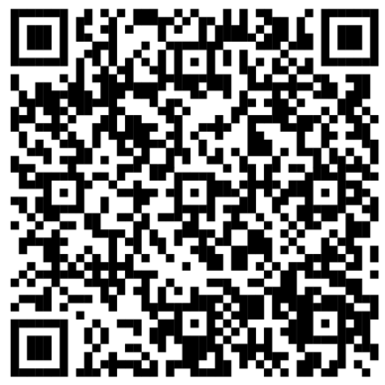
New Resource Hub
Homeowners and renters
Information about water and space heating, cooking, EV charging, incentives
Contractors
Information about training, tools, incentives
Local government representatives
Information about model policies, permitting, training, incentives
Links on the Building and Home Energy Resource Hub

Slide 7
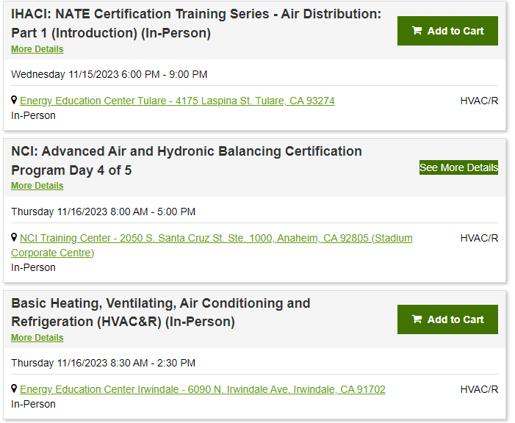
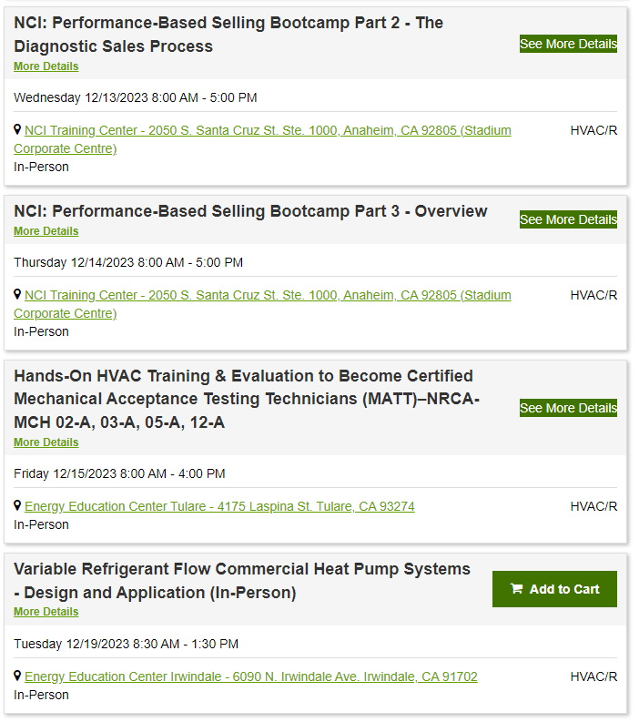
Energy Education Center

Slide 8
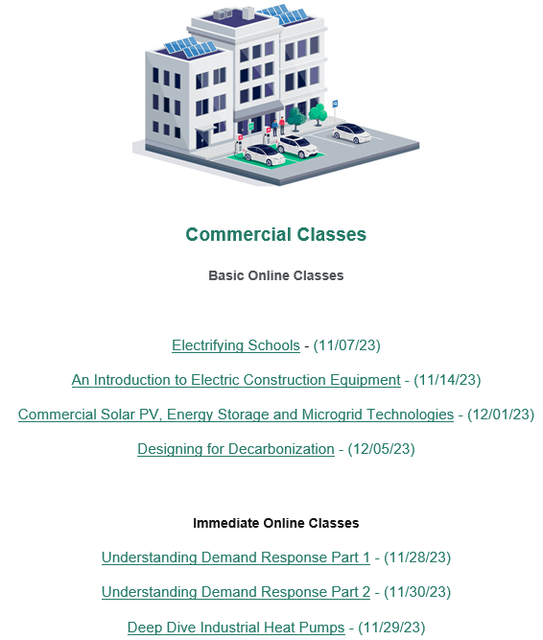
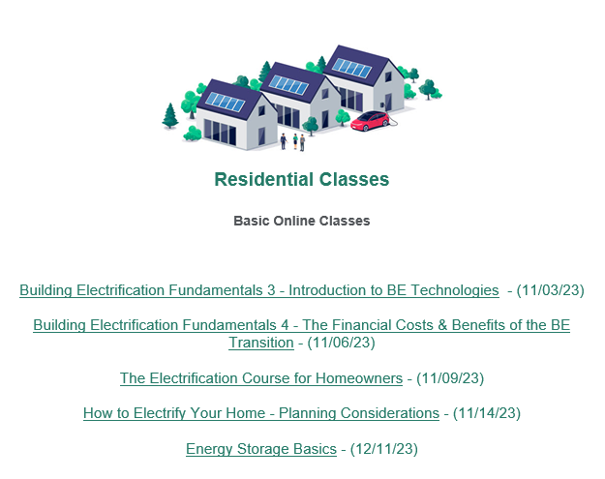
Energy Education Center

Slide 9
Mobile Education Unit Program
The Mobile Education Unit (MEU) program is an extension of the Energy Education Centers that takes clean energy education on the road across SCE’s service area. The MEU program consists of two vehicles, SCE’s wrapped sprint van and Ford Lightning, that attend community events such as job and resource fairs, college events, home shows, county fairs and much more. In addition to providing education on electrification technologies, the MEU program also promotes EEC classes and the Tool Lending Library. The goal of the MEU program is to advance clean energy adoption by engaging with residential and commercial customers in hard-to-reach, rural communities to educate them on the benefits of a cleaner California.

Slide 10
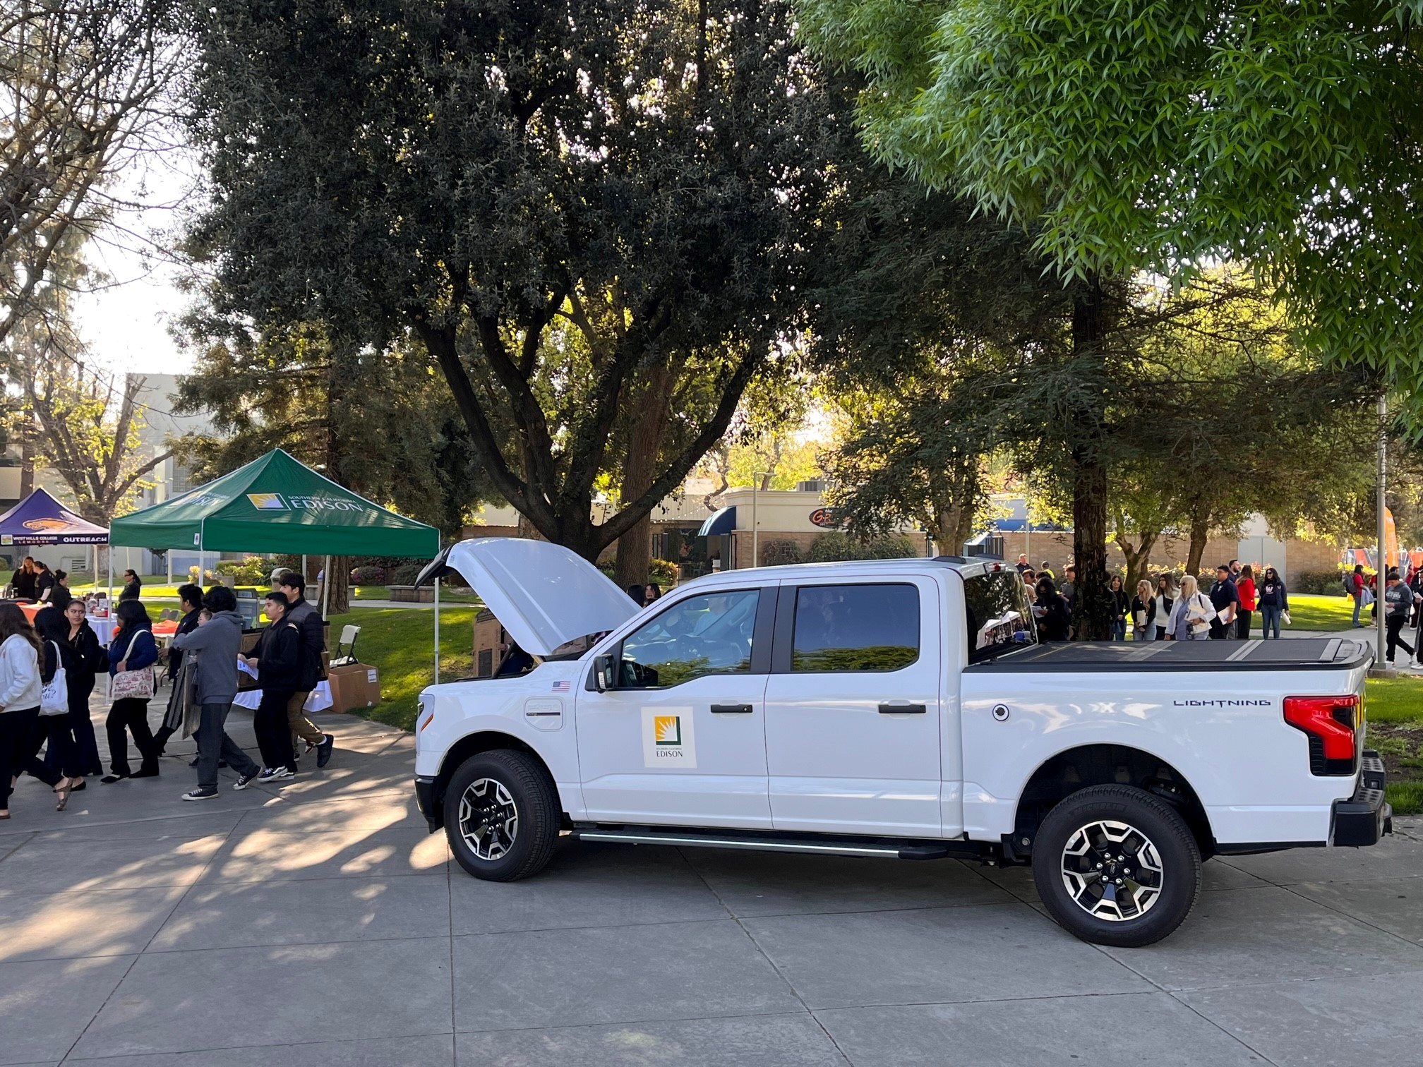
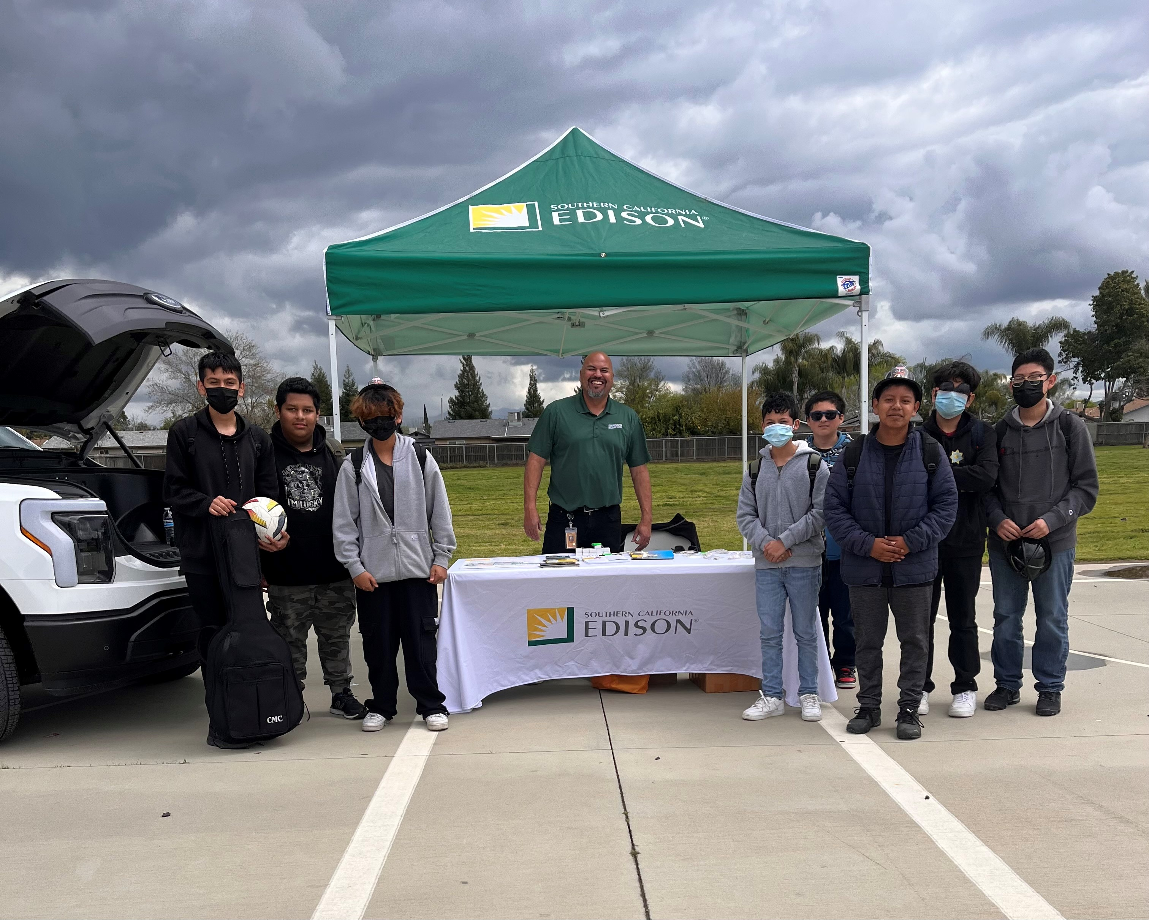
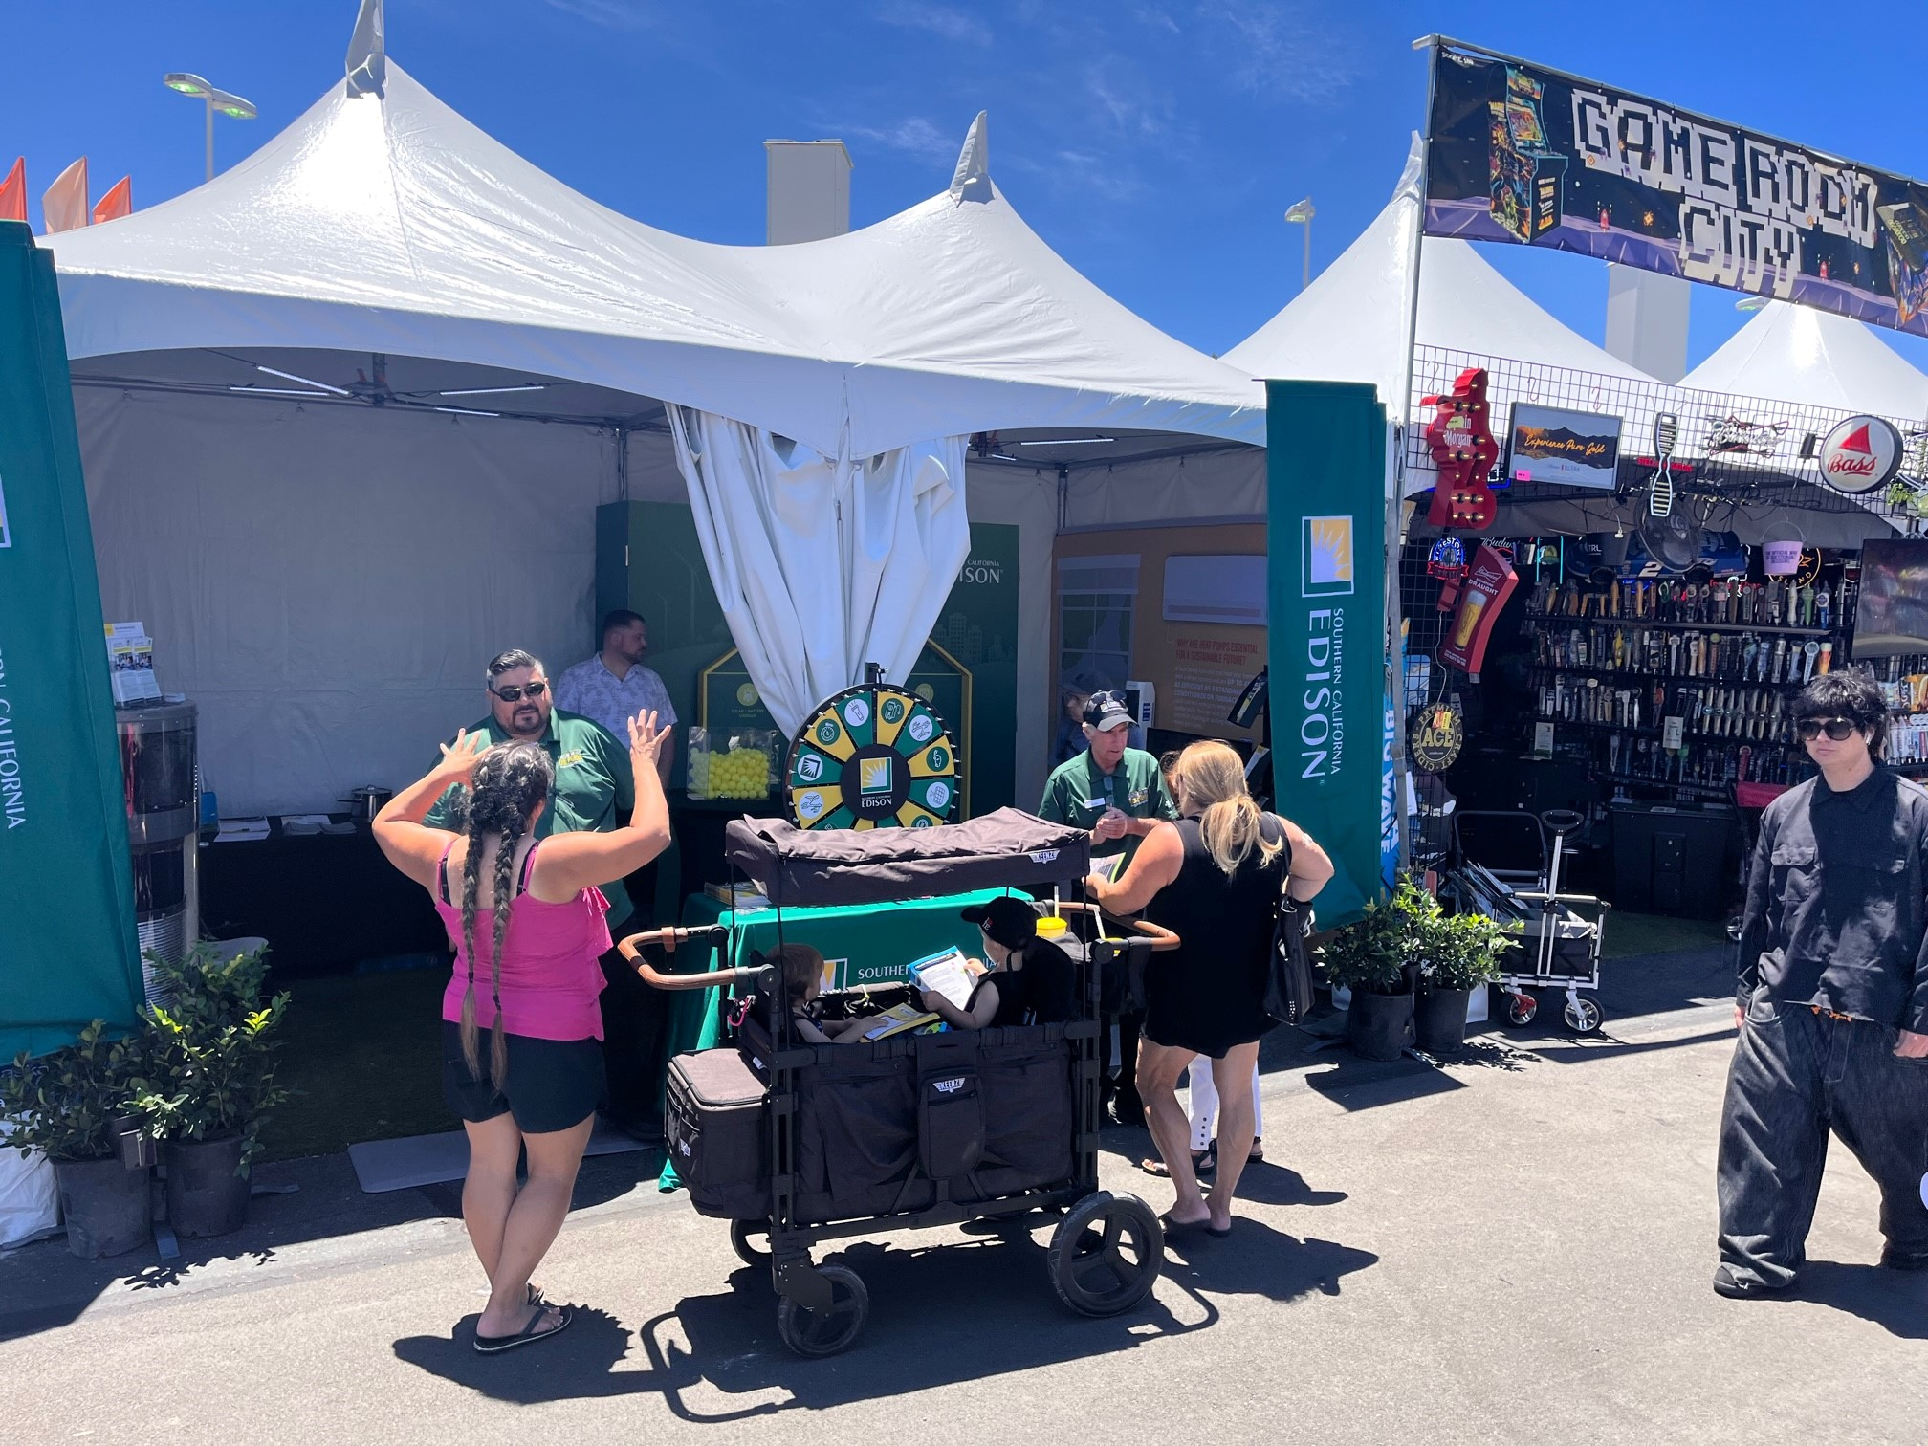
LA County Fair
College of Sequoias
Farmersville Career Day
Orange County Fair

Slide 11
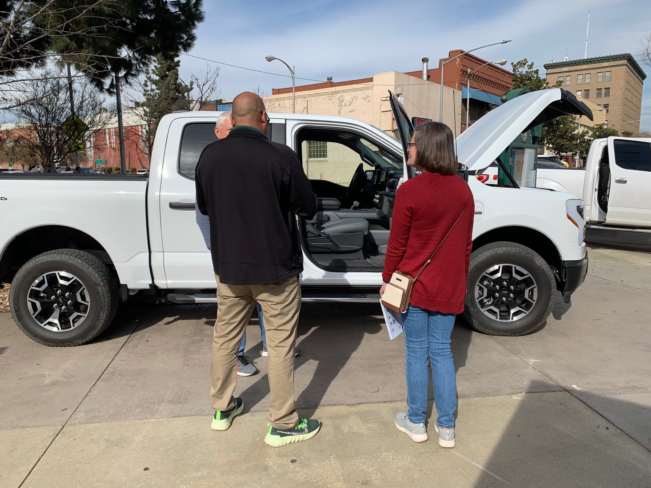
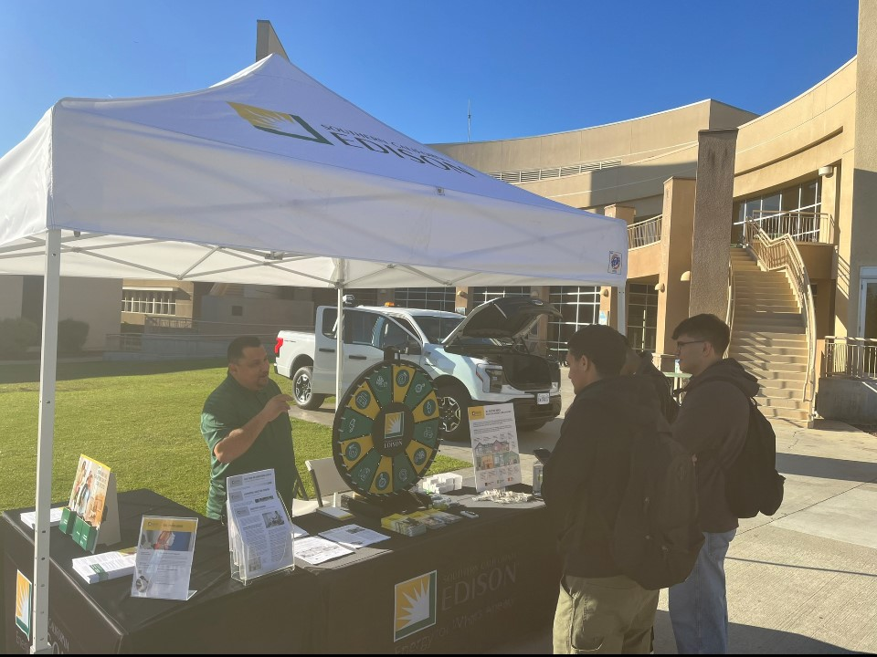
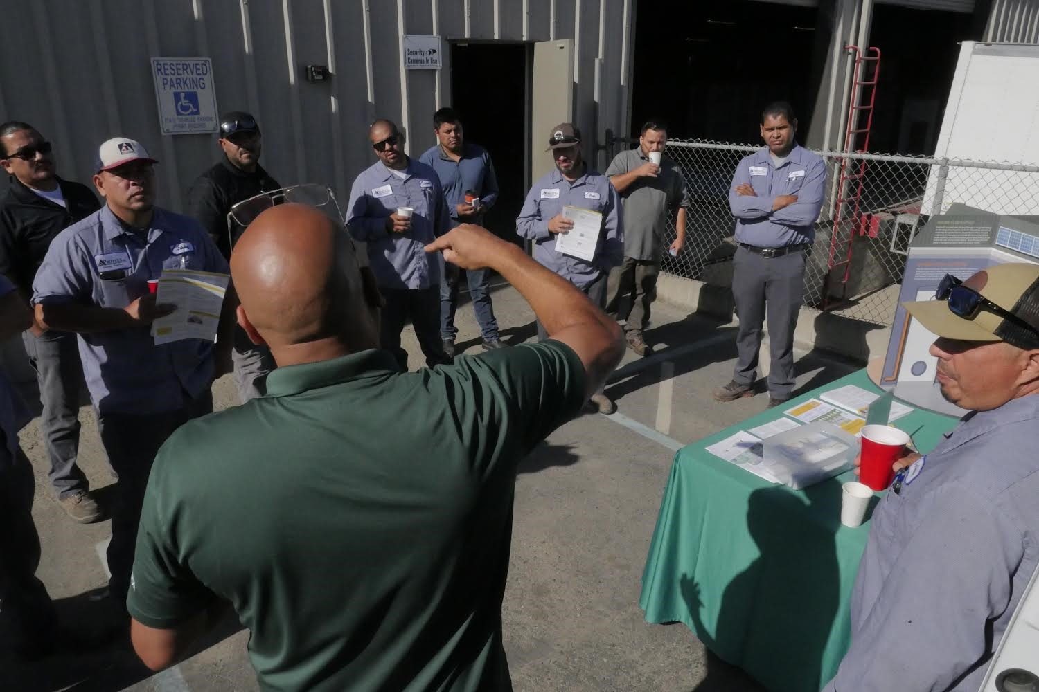
Type of engagements the MEU Program encounters
Promoting the EEC classes where one can upskill their knowledge
"My bill is too high, where can I get help" or "I'm confused about my solar bill"
Promoting SCE's low-income programs (CARE/FERA/ESA)
"Why is California promoting EVs and electrification if the electrical grid can't handle it"?

Slide 12
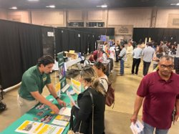
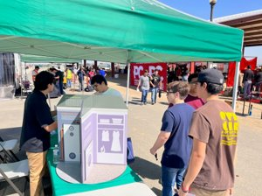
MEU events so far in 2023
68 events (so far)
41,400 engagements
Notable events in October
Visalia Job Fair
South Valley Industrial Summit
GreenPort, Port of Long Beach
Sustainability Event in San Gabriel
CABEC 2023 Annual Conference
Pinkham School STEM Event, Visalia
COS Career Day, Visalia 10/25
East Kern Career Expo, Mojave 10/27
Chino Hill Business Expo, 10/28
Upcoming events in 4th Quarter– Trades Day (Inland Empire), Taste of Soul in LA, SCANPH (Pasadena), Realtors Conference in Anaheim

Slide 13
BORROW A TOOL WITH 3 EASY STEPS:
Create an account
View our inventory
Reserve your items
sce.myturn.com

Slide 14
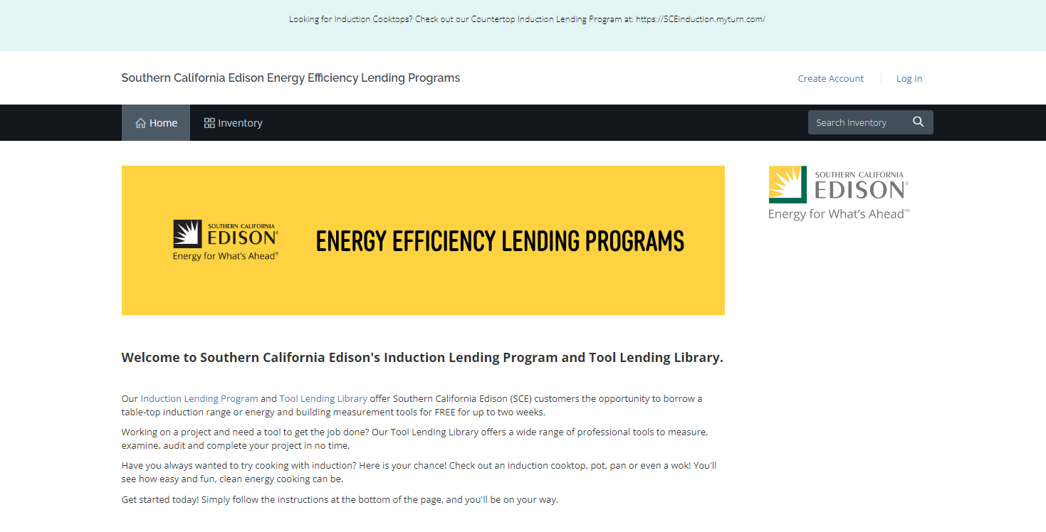

Slide 16
6
Time of Use

